Slide 1
ASP.NET WebAPI intro

Slide 2
Agenda
Problem
XML / JSON
API
ASP.NET

Slide 3
Where Do Data come from
Any one system can’t contain all the needed data
So how does an application get data from another application?
EPJ
CPR
EG Healthcare
Sundhed.dk

Slide 4
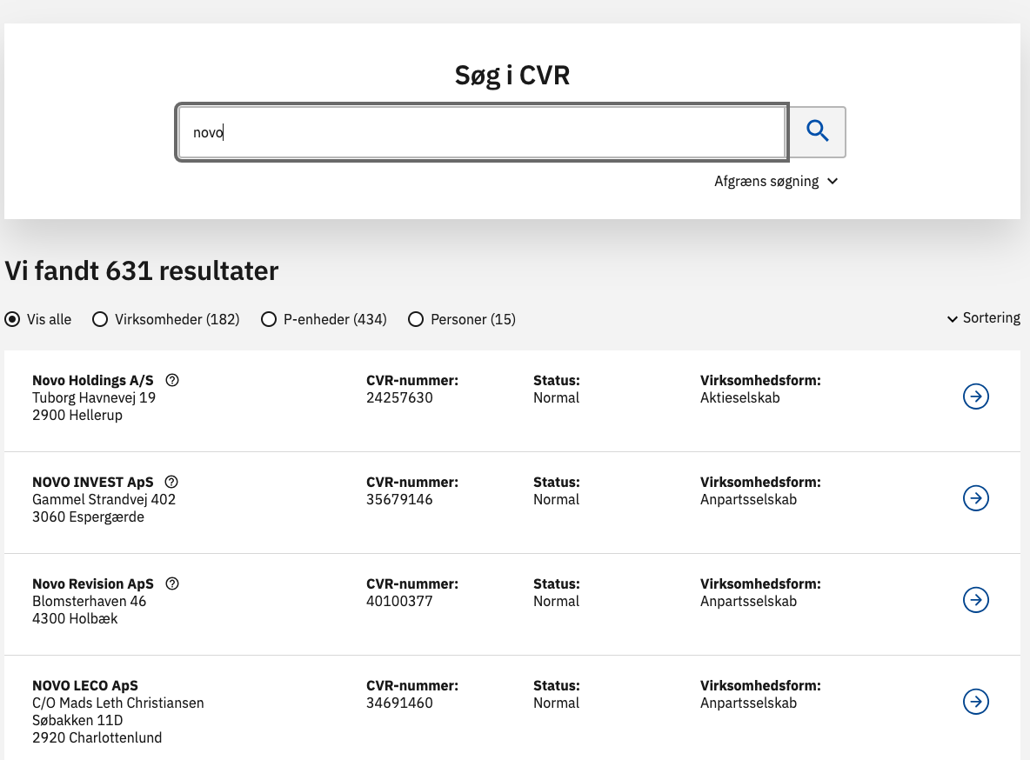
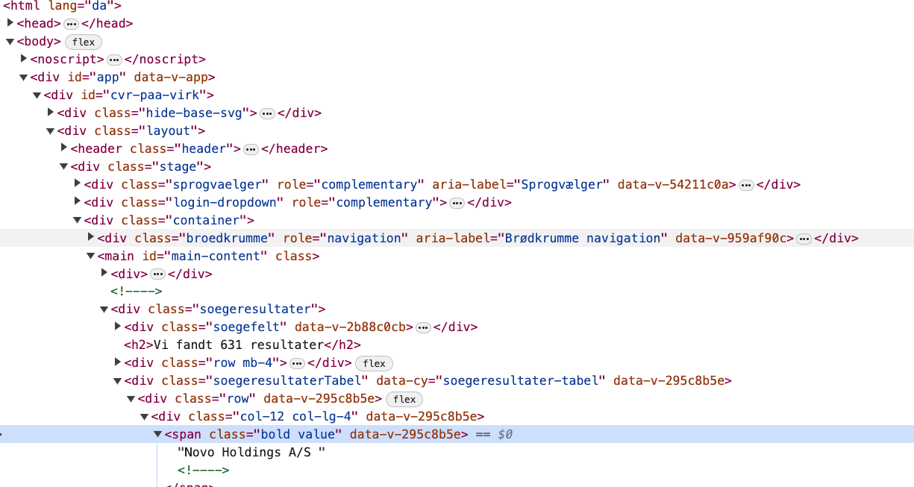
Webpages and HTML

Slide 5
Json or XML
Data format better suited for applications
JSON
E.g. https://cvrapi.dk/api?search=novo&country=dk
JavaScript Object Notation
Lightweight
Simple to parse with https://www.newtonsoft.com/json
XML
E.g. https://cvrapi.dk/api?search=novo&country=dk&format=xml
Extensible Markup language
Verbose
Parse with https://learn.microsoft.com/en-us/dotnet/api/system.xml.xmldocument?view=net-6.0

Slide 6
URL
Uniform resource locator
Key
Value
https://cvrapi.dk/api?search=novo&country=dk
Protocol
Domain
Filename
Parameters

Slide 7
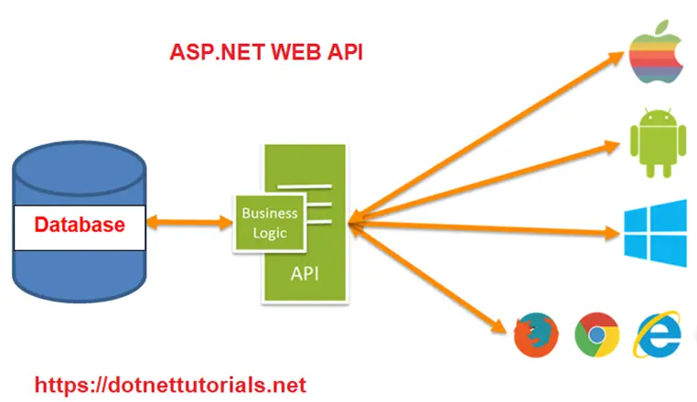
ASP.NET Web Api
This is Microsoft's recommended way of creating an API
Application Programming Interface

Slide 8
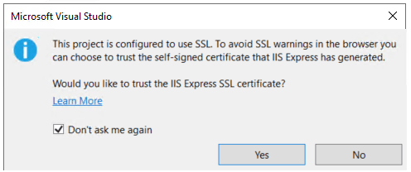
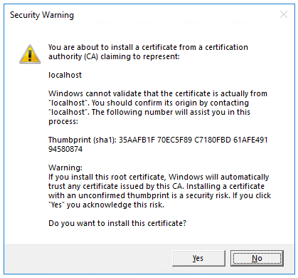
Creating a project
In Visual Studio
In the File menu choose New -> Project
Search for Web API and select ‘ASP.NET Core Web API’
In the Additionals information menu
Make sure you uses .NET 6.0 or higher
Make sure you Use Controllers are selected
Run the project.

Slide 9
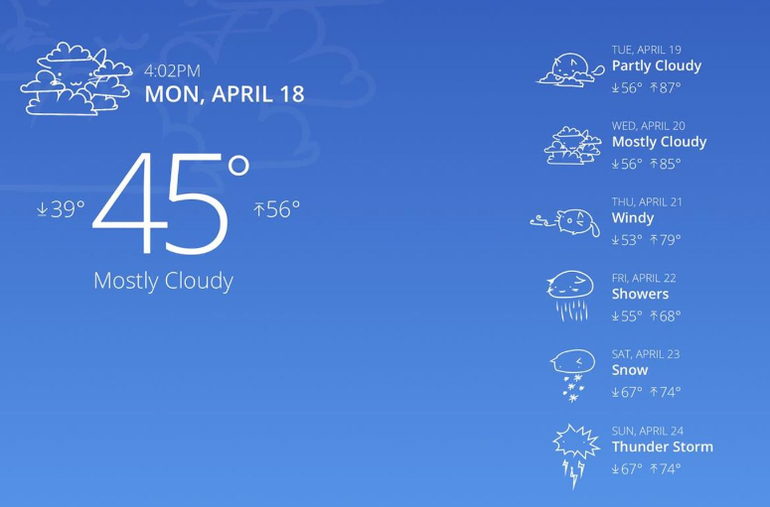
Generated Code
WeatherForecast.cs
Controllers/
WeatherForecastController.cs
Program.cs

Slide 10
Generated Code - model
public class WeatherForecast
{
public DateOnly Date { get; set; }
public int TemperatureC { get; set; }
public int TemperatureF => 32 + (int)(TemperatureC / 0.5556);
public string? Summary { get; set; }
}
WeatherForecast.cs
Controllers/
WeatherForecastController.cs
Program.cs

Slide 11
Generated Code
[ApiController]
[Route("[controller]")]
public class WeatherForecastController : ControllerBase {
[HttpGet(Name = "GetWeatherForecast")]
public IEnumerable<WeatherForecast> Get() {
return Enumerable.Range(1, 5).Select(index => new
WeatherForecast{
Date = DateOnly.FromDateTime(
DateTime.Now.AddDays(index)),
TemperatureC = Random.Shared.Next(-20, 55),
Summary = Summaries[
Random.Shared.Next(Summaries.Length)]
})
.ToArray();
}
}
WeatherForecast.cs
Controllers/
WeatherForecastController.cs
Program.cs
Notes:
Mention this is an endpoint

Slide 12
Generated Code
var builder = WebApplication.CreateBuilder(args);
// Add services to the container.
builder.Services.AddControllers();
builder.Services.AddEndpointsApiExplorer();
builder.Services.AddSwaggerGen();
var app = builder.Build(); // Configure the HTTP request pipeline.
if (app.Environment.IsDevelopment()) {
app.UseSwagger();
app.UseSwaggerUI();
}
app.UseHttpsRedirection();
app.UseAuthorization();
app.MapControllers();
app.Run();
WeatherForecast.cs
Controllers/
WeatherForecastController.cs
Program.cs

Slide 13
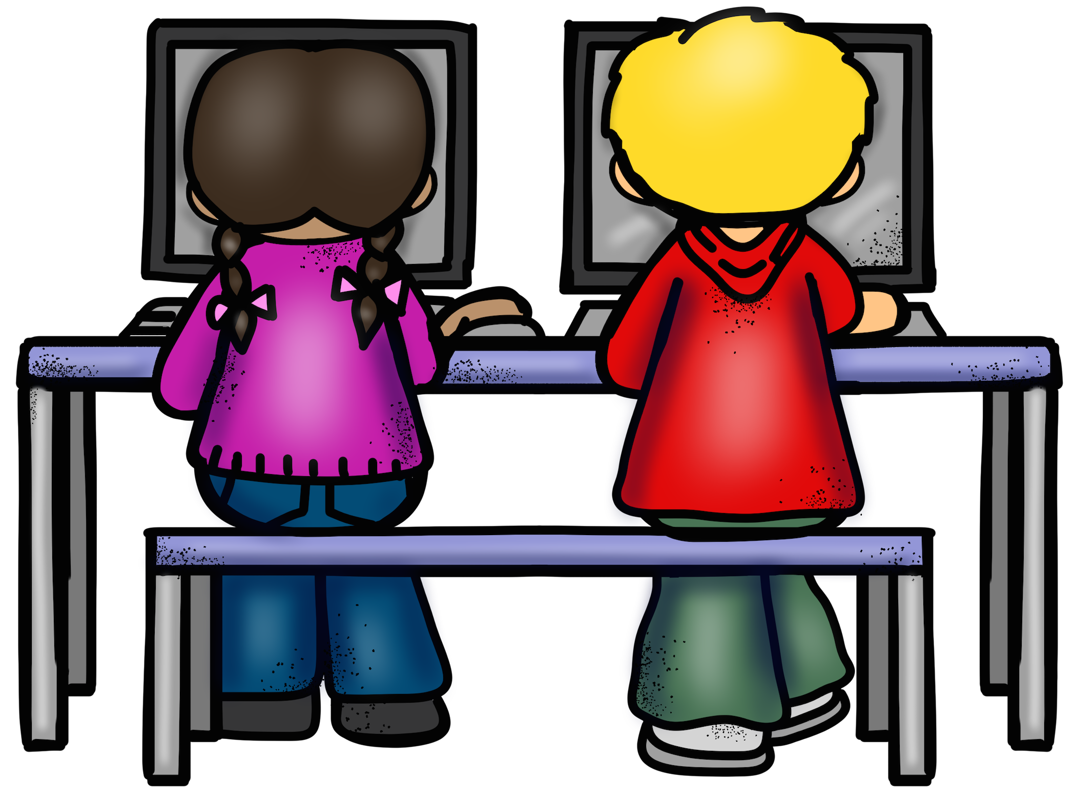
Exercises
Solve 1 and 2
Jump to Bonus when done

Slide 14
Requests
[HttpGet("{id}")]
public async Task<ActionResult<TodoItem>> GetTodoItem(long id) {
// GET todoItem
// TodoItem todoItem = …
if (todoItem == null) {
return NotFound();
}
return todoItem;
}
HTTP Verbs
GET
POST
PUT
PATCH
DELETE
Used to return resources from a web server API (one or many)

Slide 15
Task + async/Await
You will see this in much greater details in SW4SWD
Task is a lightwait thread.
“All” methods that is contains ‘async’ in name returns a task.
Task<T> can contain data.
await unwraps (among other things) inner data
string stringData = await httpClient.GetStringAsync(URL);
If you uses await in a method body, the body needs to be decorated with async and return a Task

Slide 16
Requests
[HttpPost]
public async Task<ActionResult<TodoItem>> PostTodoItem(TodoItem todoItem)
{
return Created(“todoitem”, todoItem);
//return CreatedAtAction(nameof(GetTodoItem), new { id = todoItem.Id }, todoItem);
}
HTTP Verbs
GET
POST
PUT
PATCH
DELETE
Used to create new resources on the web server

Slide 17
Requests
[HttpPut("{id}")]
public async Task<IActionResult> PutTodoItem(long id, TodoItem todoItem)
{
if (id != todoItem.Id) {
return BadRequest();
}
return NoContent();
}
HTTP Verbs
GET
POST
PUT
PATCH
DELETE
Used to update existing resources on the server

Slide 18
Requests
[HttpDelete("{id}")]
public async Task<IActionResult> DeleteTodoItem(long id)
{
var todoItem = null; // Find resources somewhere
if (todoItem == null) {
return NotFound();
} return NoContent();
}
HTTP Verbs
GET
POST
PUT
PATCH
DELETE
Used to delete resources from the

Slide 19
Requests
HTTP Verbs
GET
POST
PUT
PATCH
DELETE
Used to update resources from partial documents

Slide 20
HTTP REsponse codes
Informational responses (100 – 199)
Successful responses (200 – 299)
200 OK
201 CREATED
204 NO CONTENT
Redirection messages (300 – 399)
NOT MODIFIED
Client error responses (400 – 499)
403 FORBIDDEN
404 NOT FOUND
Server error responses (500 – 599)
500 INTERNAL SERVER ERROR

Slide 21
IActionResult
Helper methods for creating Results
Ok(), NoContent(), etc…
IActionResult
ActionResult
StatusCodeResult
ObjectResult
OkResult
NoContentResult
CreatedResult

Slide 22
Exercises
Continue on 1 and 2
Solve 3->
Jump to Bonus when done

